Slide 1

ROCKBUSTER STELTH
DATA ANALYSIS
Shrabanti Baidya

Slide 2

INTRODUCTION
Rockbuster Stealth LLC is a movie rental company that used to have stores around the world . Facing stiff competition from streaming services such as Netflix and amazon prime , the Rockbuster Stealth management team is planning to use its existing movie licences to launch an online video rental service in order to stay competitive.
This Photo by Unknown Author is licensed under CC BY-NC-ND

Slide 3

The Business questions guiding the following analysis are :
Which movies contributed the most/least to revenue gain?
What was the average rental duration for all videos?
Which countries are Rockbuster customers based in?
Where are customers with a high lifetime value based in ?
Do sales figures vary between geographic regions?

Slide 4
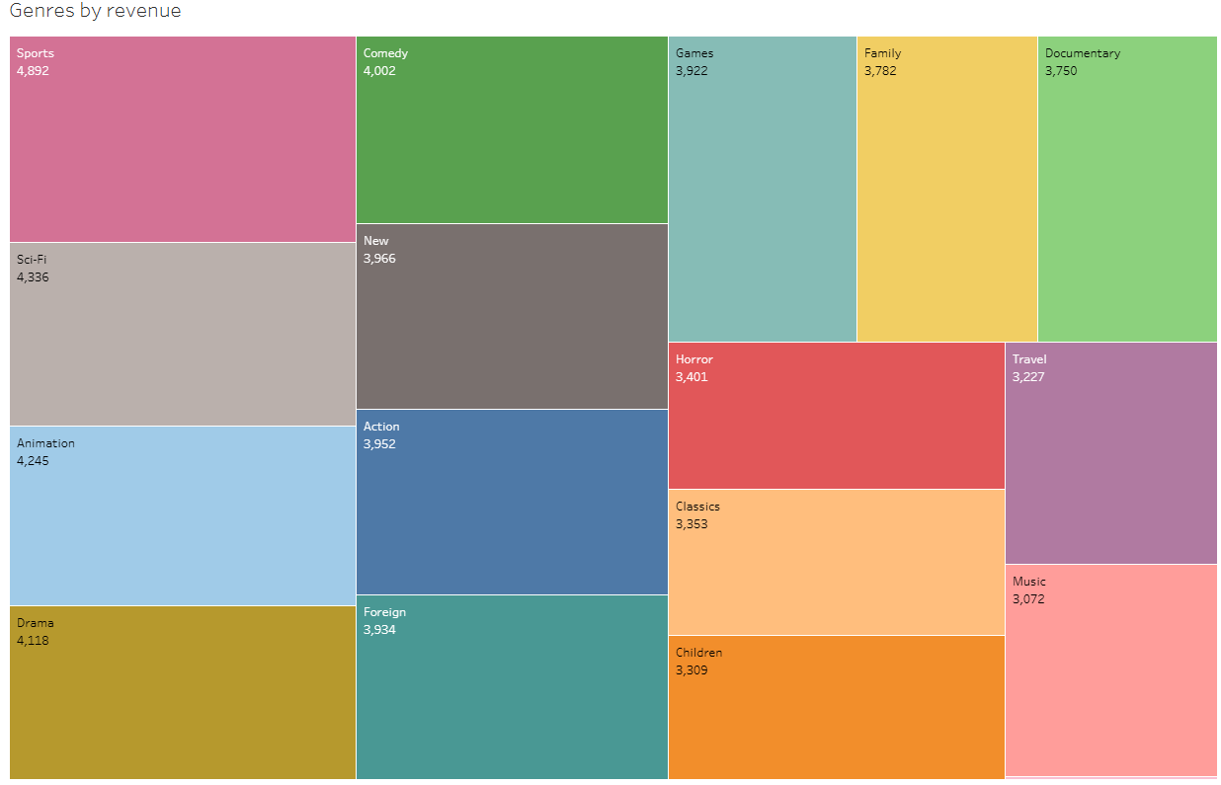
Which movie contributed the most/least to revenue gain?
https://public.tableau.com/views/exercise3_10genrerevenue/genre?:language=en-US&publish=yes&:sid=&:redirect=auth&:display_count=n&:origin=viz_share_link

Slide 5

What was the average rental duration of all movies?
 | Rental duration | Rental rate
Average | 4.98 days | $2.98
Minimum | 3 days | $0.99
Maximum | 7 days | $4.99

Slide 6
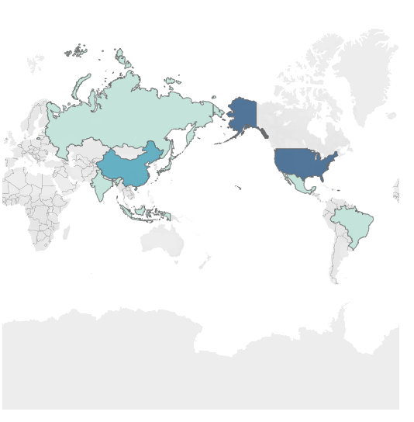
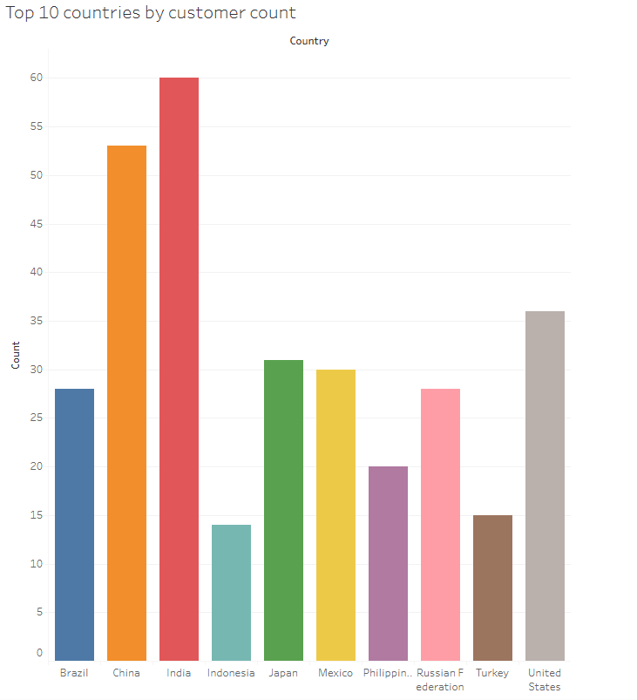
Which countries are rockbuster customers based in ?
https://public.tableau.com/shared/KN7H8B65Z?:display_count=n&:origin=viz_share_link
https://public.tableau.com/views/exercise3_10_1/Exercise3_10_1?:language=en-US&:sid=&:redirect=auth&:display_count=n&:origin=viz_share_link

Slide 7
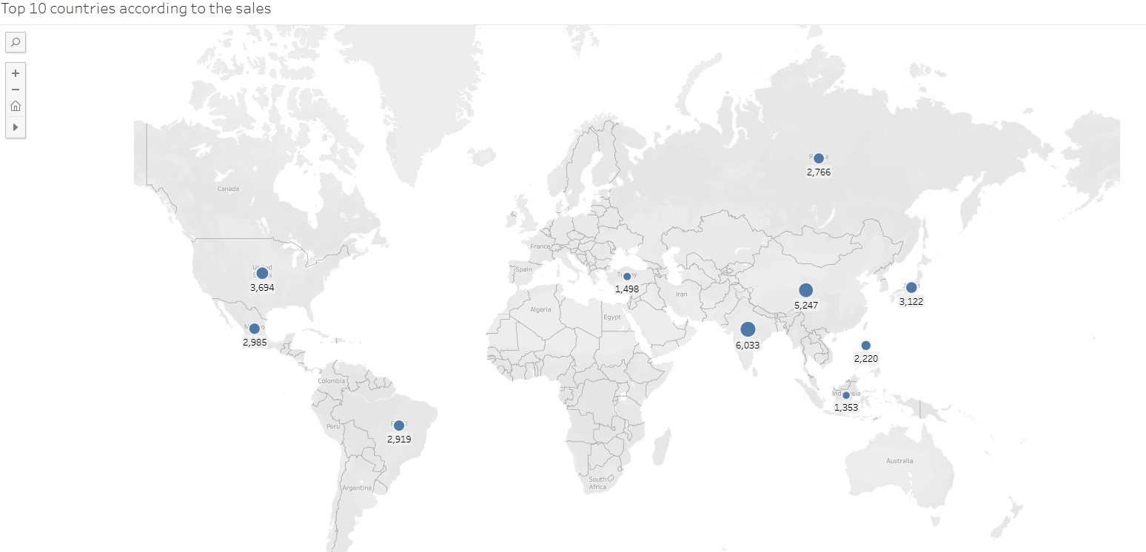
Do sales figure vary between geographic regions?
https://public.tableau.com/shared/RWQXTRK5T?:display_count=n&:origin=viz_share_link
Country | Lifetime values
India | $603279
China | $524704
United States | $369427
Japan | $312152
Mexico | $298482
Brazil | $291919
Russian Federation | $276562
Philippines | $221970
Turkey | $149849
Where the customers with high lifetime value based in?

Slide 8
Recomendation
Rockbuster Stealth should focus it’s efforts on the markets in India and China, because they have both the most customers and the most lifetime value brought in.
Regarding the genres - sports, sci-fi, animation and drama bring in the most revenue gain and new movies should mostly come from these genres. Rockuster could do another analysis into the specific viewing prefrences of the customers which bring in the most revenue and cater the online offers to them.
Loyal customers should be rewarded by for example gift codes, which they can use to get rewards (for example a reduced rate for a movie) on their online account

